Slide 1




Dipartimento di Fisica e Astronomia
Galileo Galilei
Bayesian Analysis of ARPAV time series on temperatures
arpav
Advanced statistics for physics analysis
RICCARDO CORTE
ALESSANDRO MIOTTO
LORENZO RIZZI
PROF. ALBERTO GARFAGNINI

Slide 2
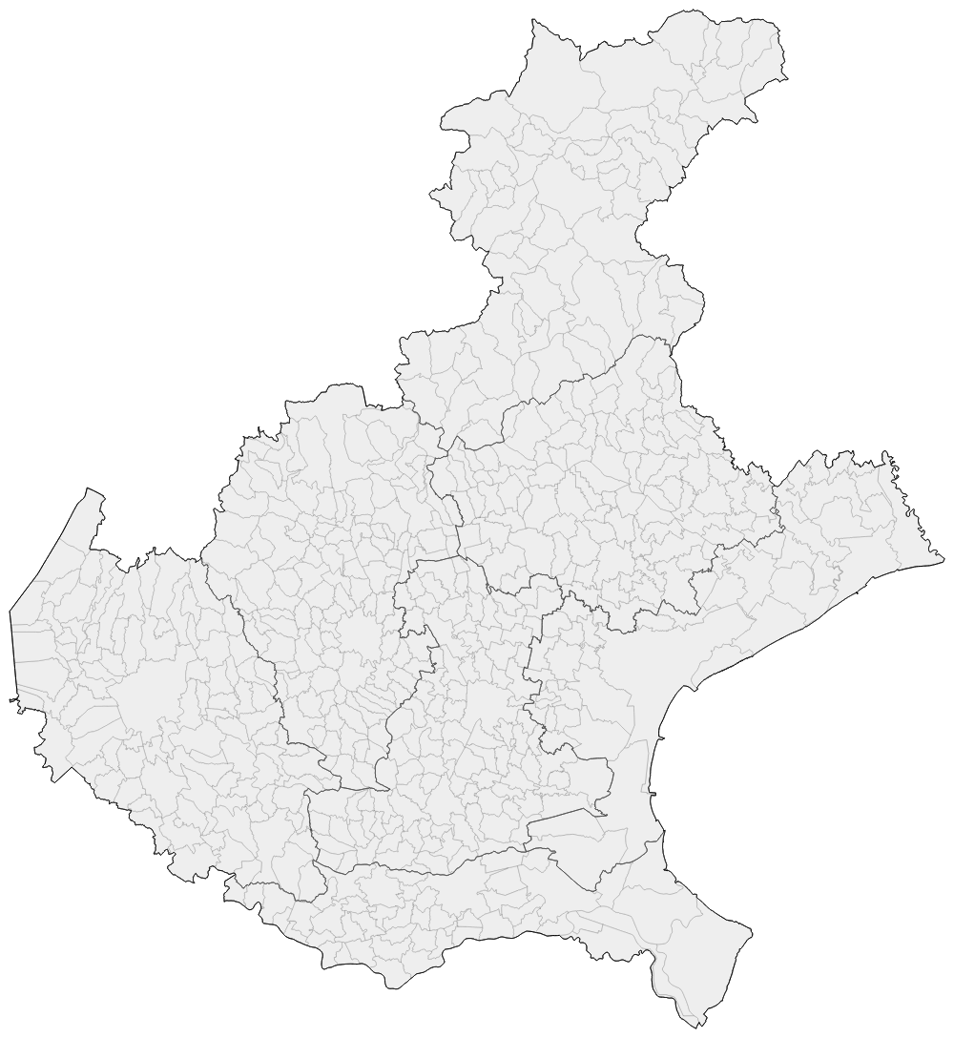
Introduction
This project analyzes ARPAV’s temperature data from four distinct stations across the Veneto region.
Our analysis is based on Bayesian regression to uncover historical trends and an ARIMA based forecasting to predict future temperatures
AURONZO DI CADORE
Lat: 46°33’33’’ N
Lon: 12°25’28’’ E
Alt over see level: 849 m
CASTELFRANCO VENETO
Lat: 45°40’00’’ N
Lon: 11°55’00’’ E
Alt over see level: 49 m
PORTO TOLLE
Lat: 44°56’58’’ N
Lon: 12°19’28’’ E
Alt over see level: -3 m
ROVERCHIARA
Lat: 45°16’10’’ N
Lon: 11°14’41’’ E
Alt over see level: 17 m

Slide 3
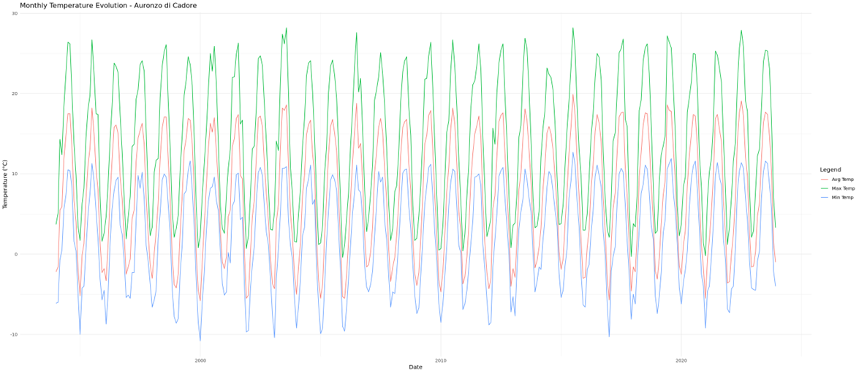
Introduction
Monthly weather data from four different stations
1994 - 2023
arpav
https://www.arpa.veneto.it/dati-ambientali/open-data/clima/principali-variabili-meteorologiche

Slide 4
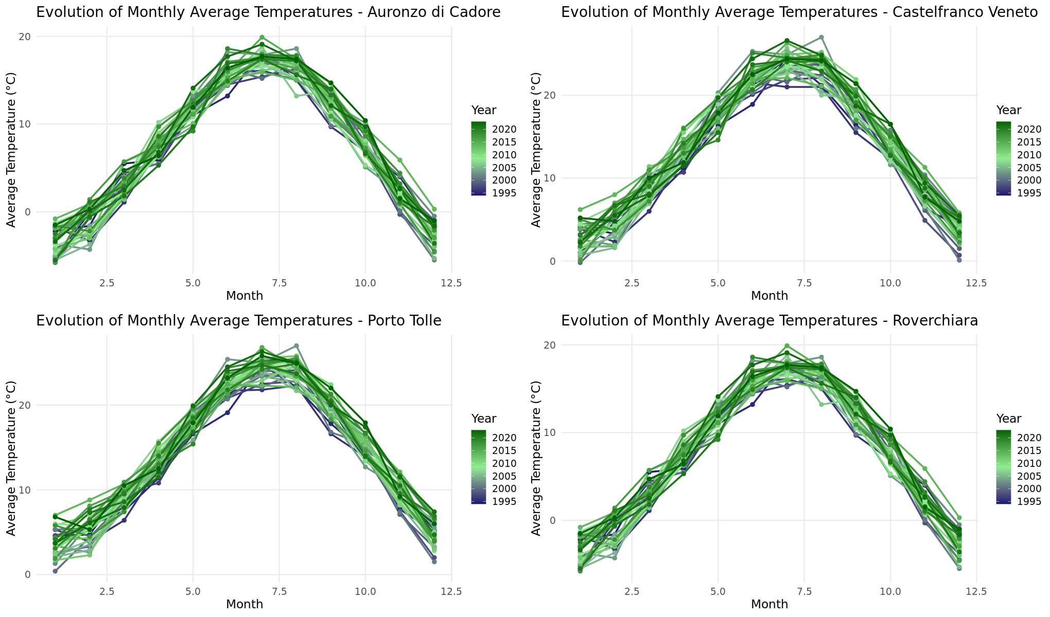
Part 0: Evolution of the temperatures over a month
Mean Values (°C) | Auronzo di Cadore | Castelfranco Veneto | Porto Tolle | Roverchiara
Maximum | 14.1 | 19.5 | 18.9 | 19.3
Average | 7.3 | 13.3 | 14.1 | 13.4
Minimum | 2.0 | 7.9 | 9.5 | 7.9

Slide 5
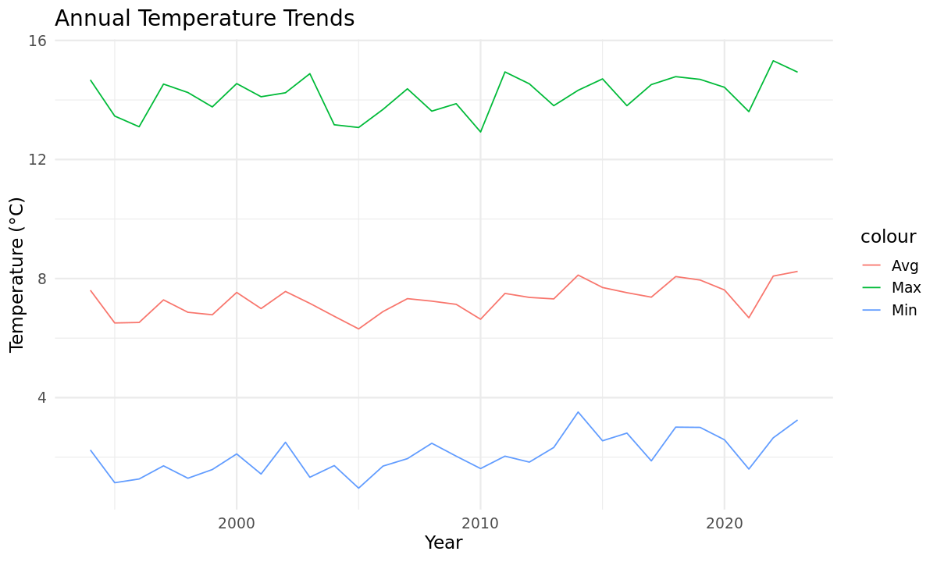
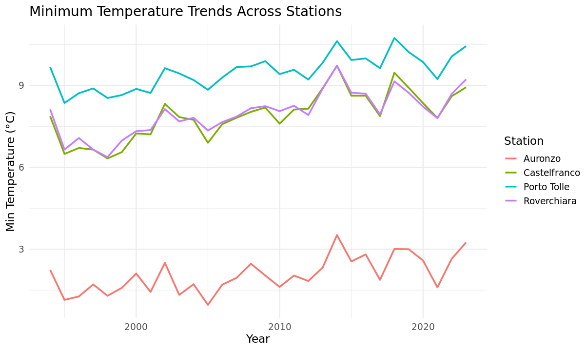
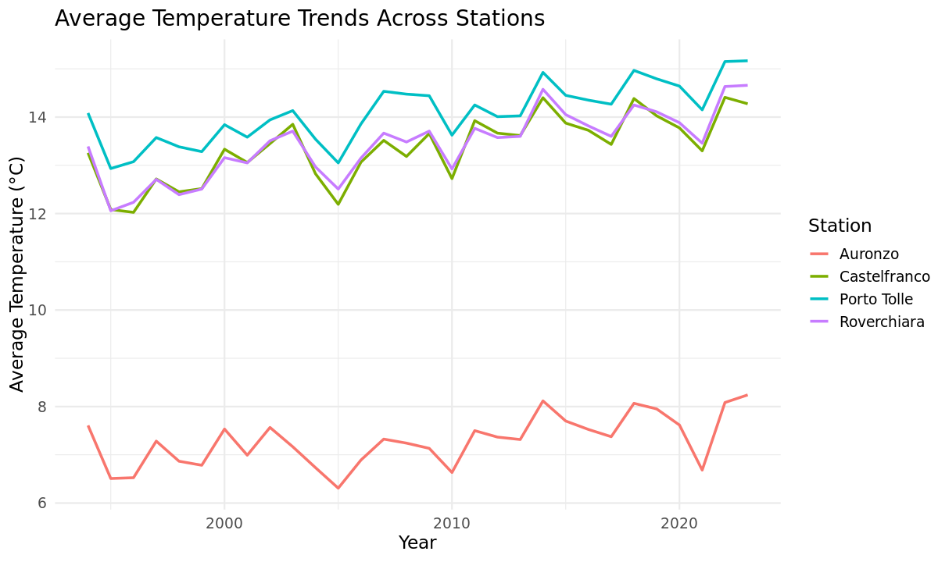
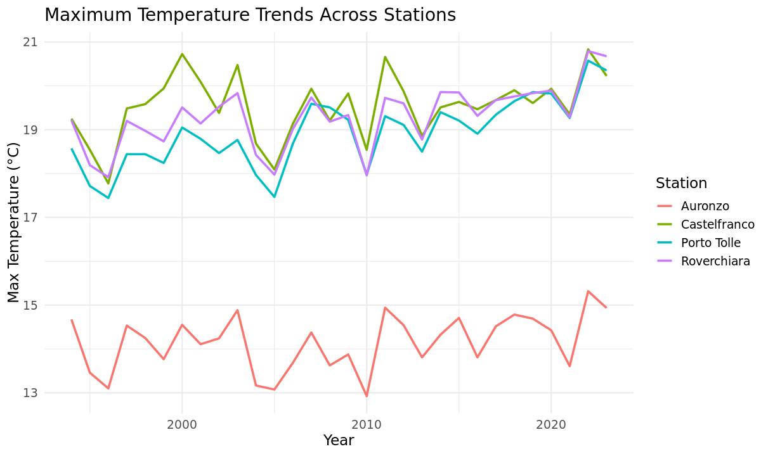
Part 1: Evolution of the temperatures over the year

Slide 6
Part 1: Evolution of the temperatures over the year

Slide 7
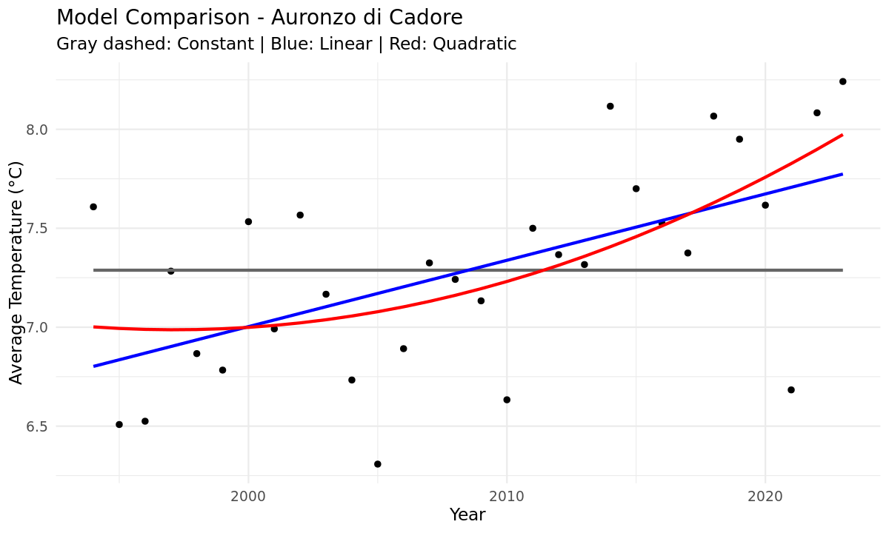
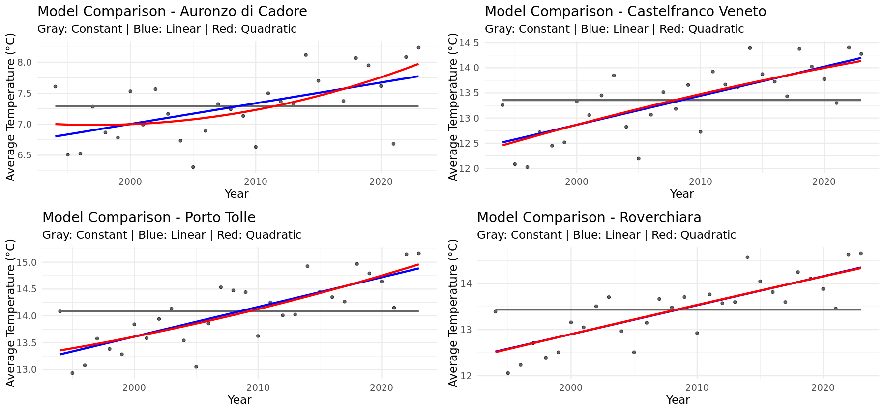
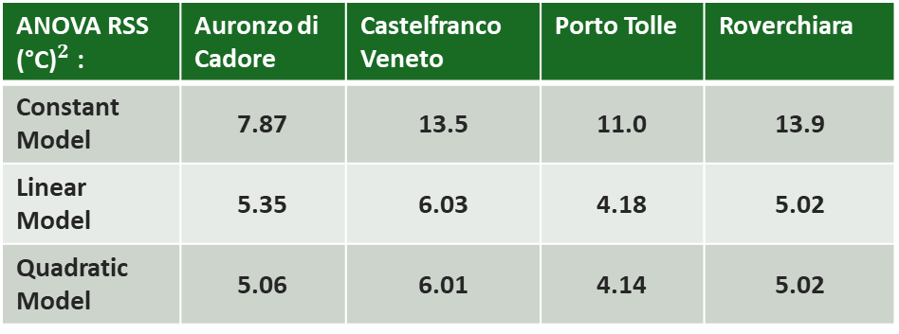
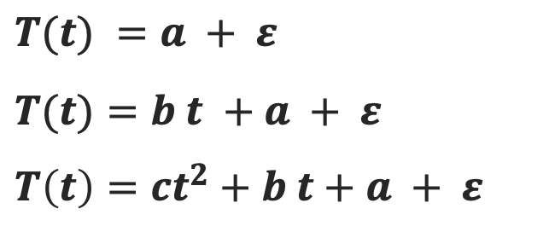
Part 1: Frequentist regression
ANOVA RSS ${\text{(°}\text{C}\text{)}}^{2}$: | Auronzo di Cadore | Castelfranco Veneto | Porto Tolle | Roverchiara
Constant Model | 7.87 | 13.5 | 11.0 | 13.9
Linear Model | 5.35 | 6.03 | 4.18 | 5.02
Quadratic Model | 5.06 | 6.01 | 4.14 | 5.02
$$T(t) =a + ε$$
$$T(t)=b t +a + ε$$
$$T\left(t\right)=ct^{2}+b t+a + ε$$

Slide 8

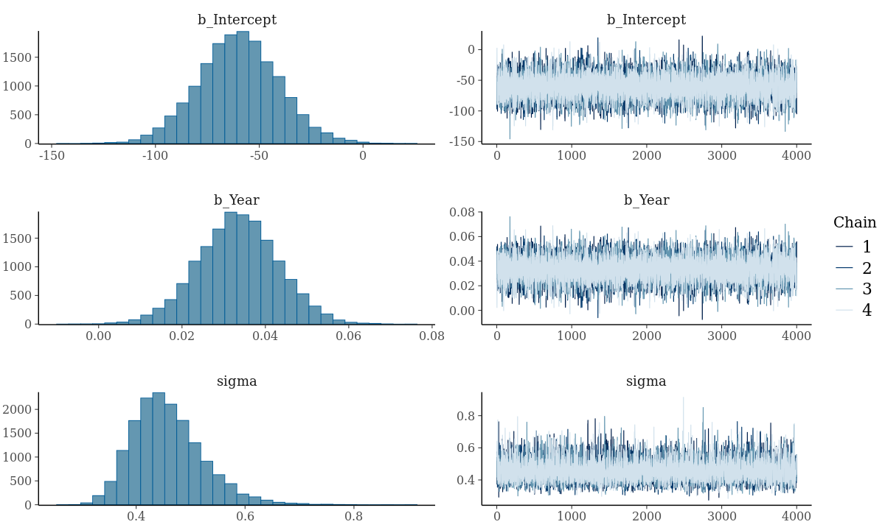
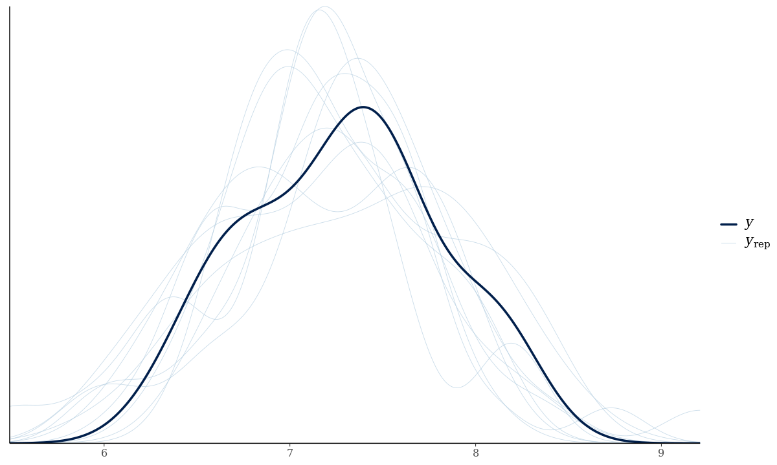
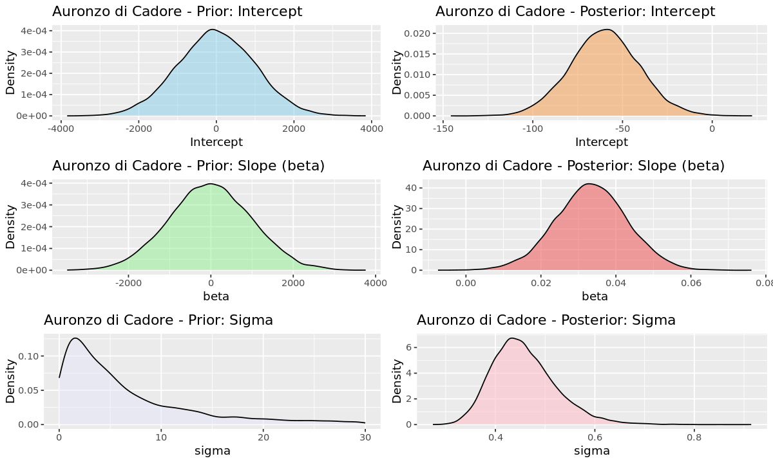
Part 1: Bayesian Linear Regression using STAN
5000 iterations
1000 warmup
4 chains
STAN
Parameters prediction | Auronzo Di Cadore | Castelfranco Veneto | Porto Tolle | Roverchiara
Intercept | -59.92 | -102.6 | -96.96 | -112.92
Slope | 0.03 | 0.06 | 0.06 | 0.06
Sigma | 0.46 | 0.49 | 0.41 | 0.44

Slide 9
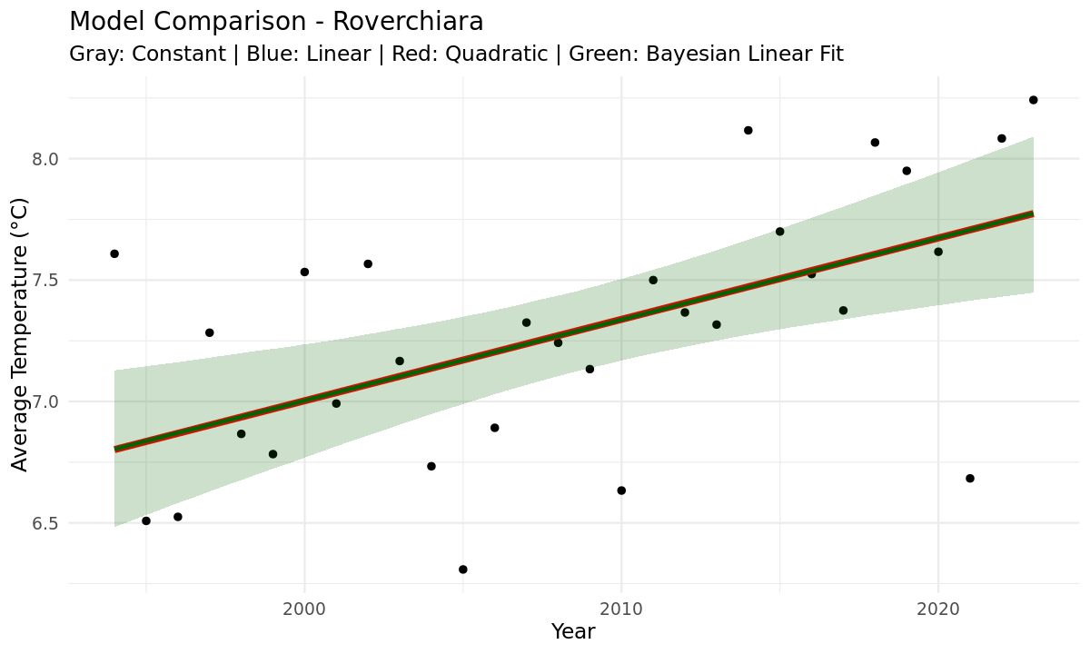
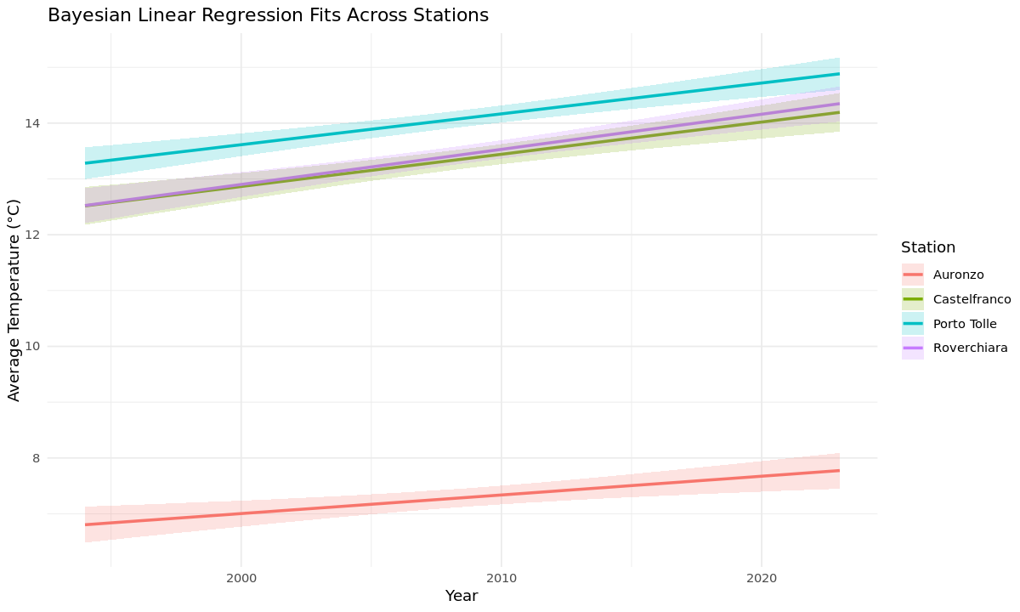
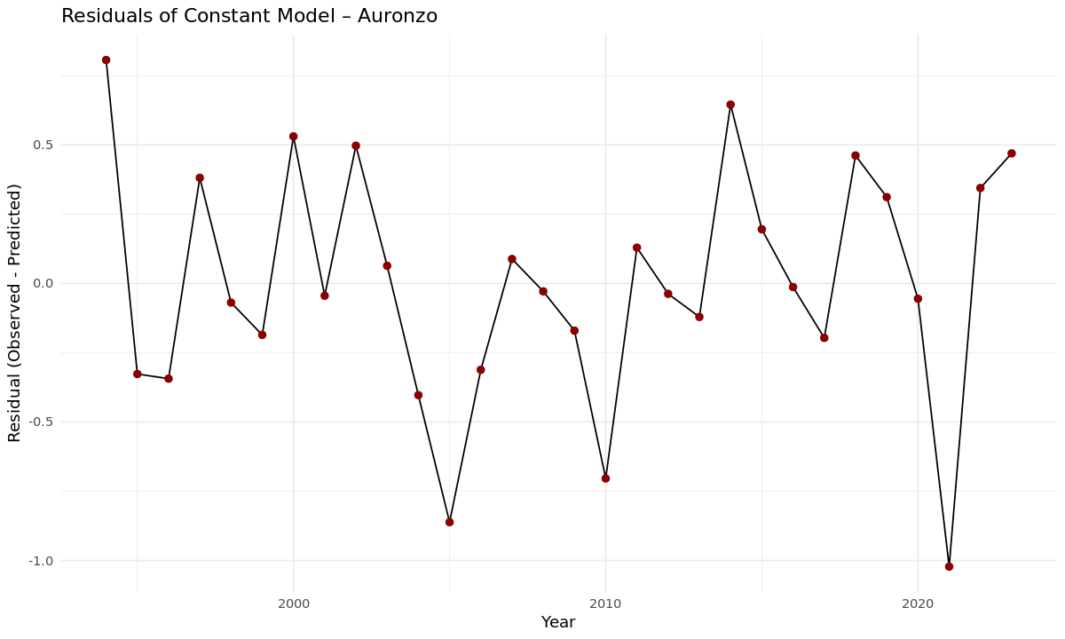
Part 1: Bayesian and Frequentist approach comparison
The results are consistent between bayesian and frequentist approach

Slide 10
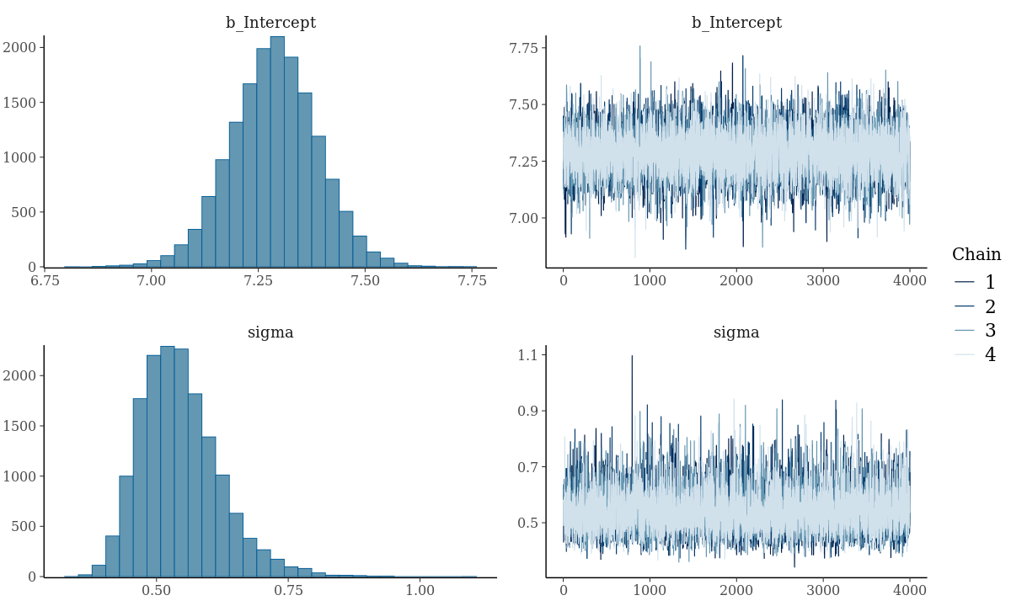
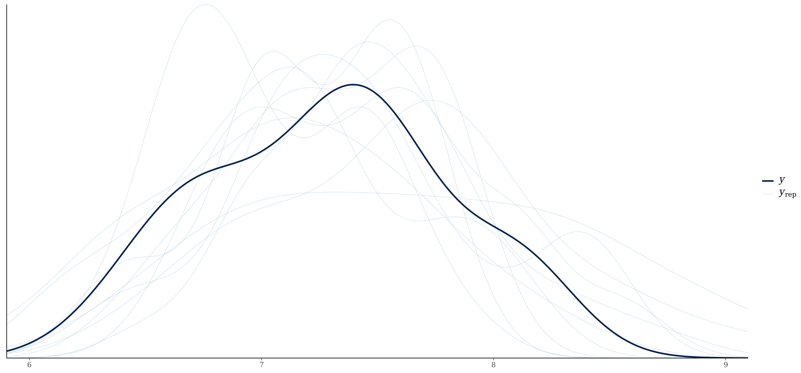
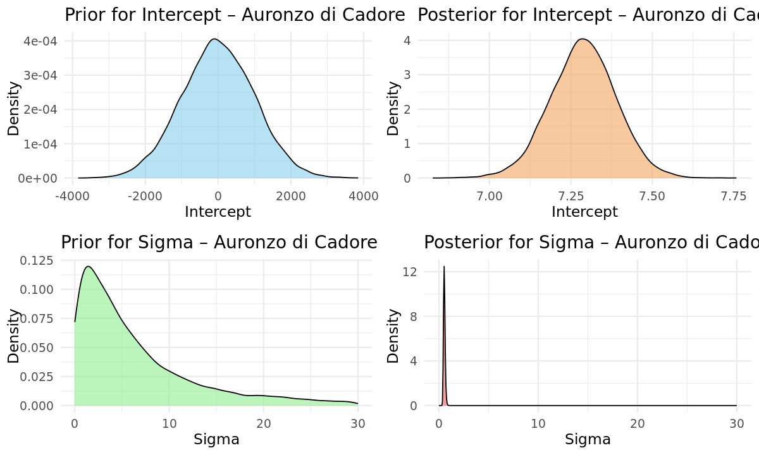
Part 1: Constant regression with STAN
5000 iterations
1000 warmup
4 chains
STAN
Parameters prediction | Auronzo Di Cadore | Castelfranco Veneto | Porto Tolle | Roverchiara
Intercept | 7.29 | 13.35 | 14.08 | 13.44
sigma | 0.54 | 0.72 | 0.65 | 0.72

Slide 11
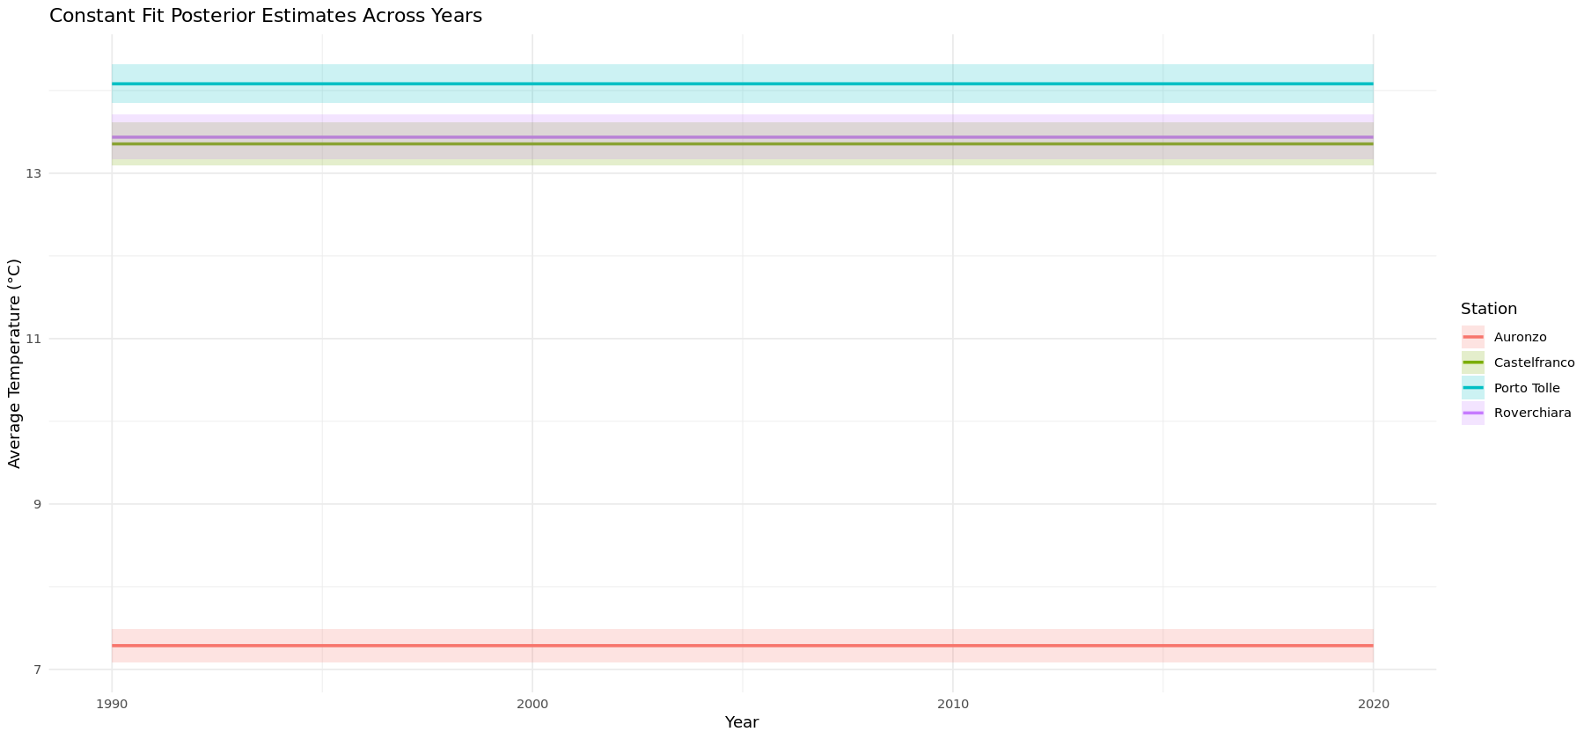
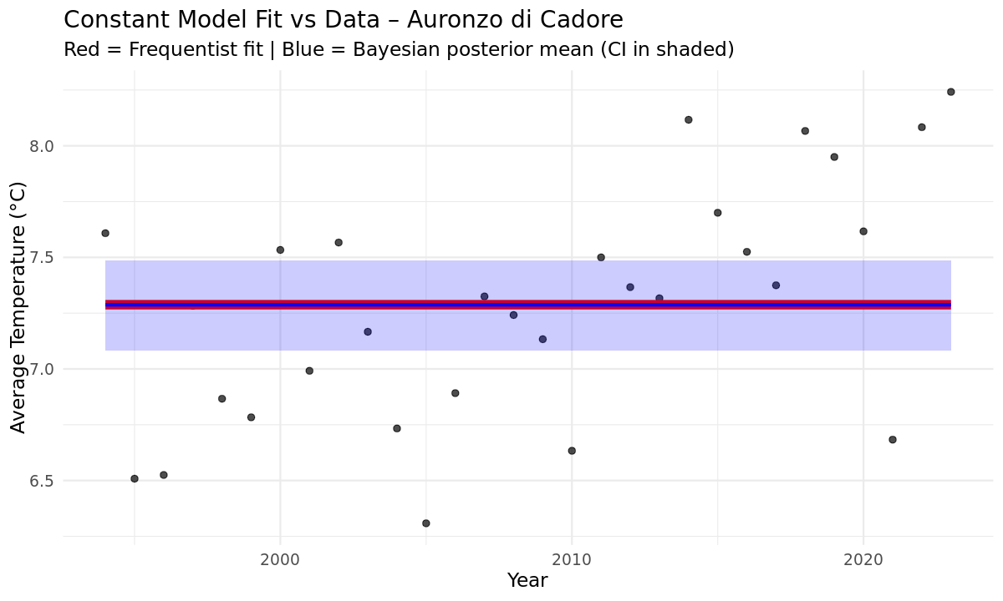
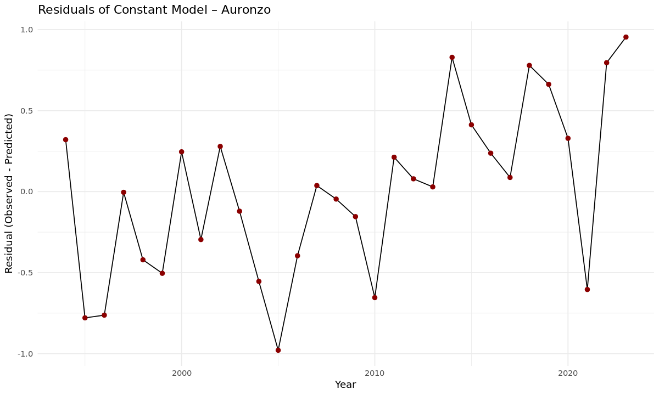
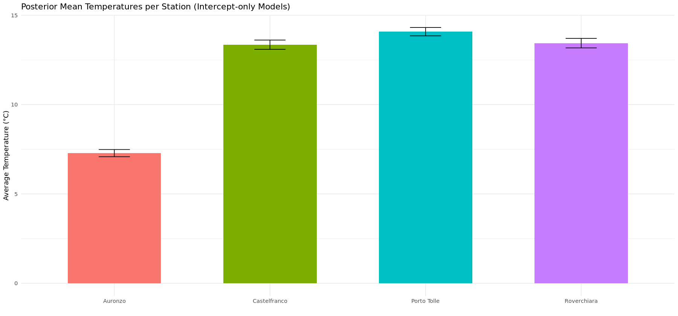
Part 1: Constant regression

Slide 12
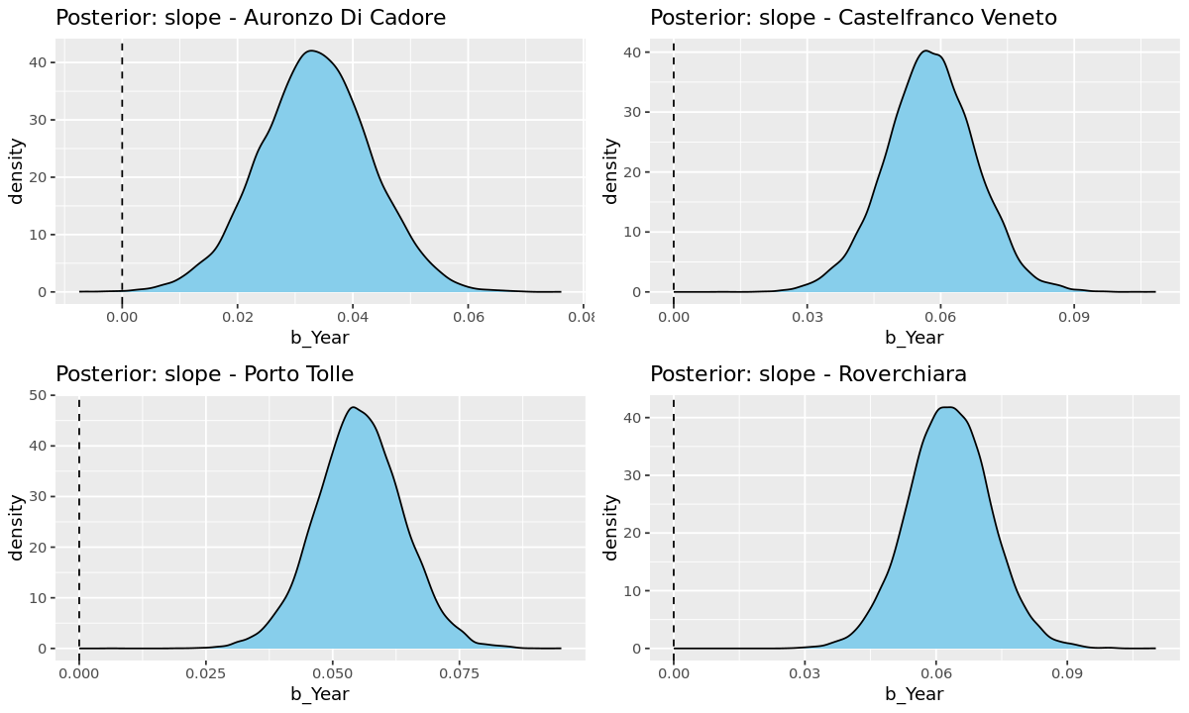
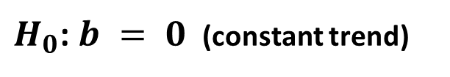
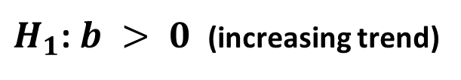
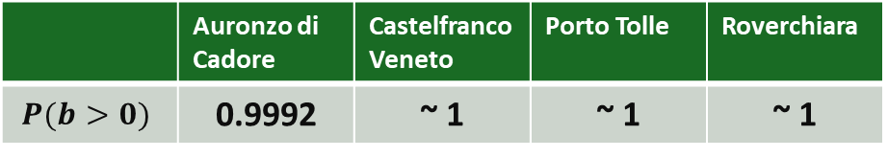
Part 1: Hypothesis Testing
$H_{0}$: $b = 0$ (constant trend)
 | Auronzo di Cadore | Castelfranco Veneto | Porto Tolle | Roverchiara
$$P(b>0)$$ | 0.9992 | ~ 1 | ~ 1 | ~ 1
$H_{1}$: $b > 0$ (increasing trend)

Slide 13
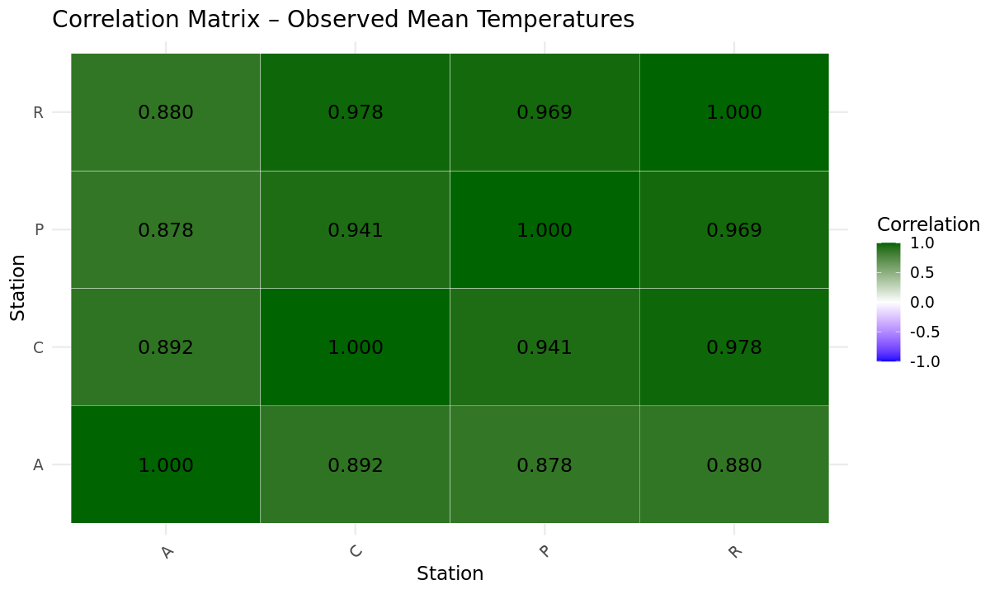
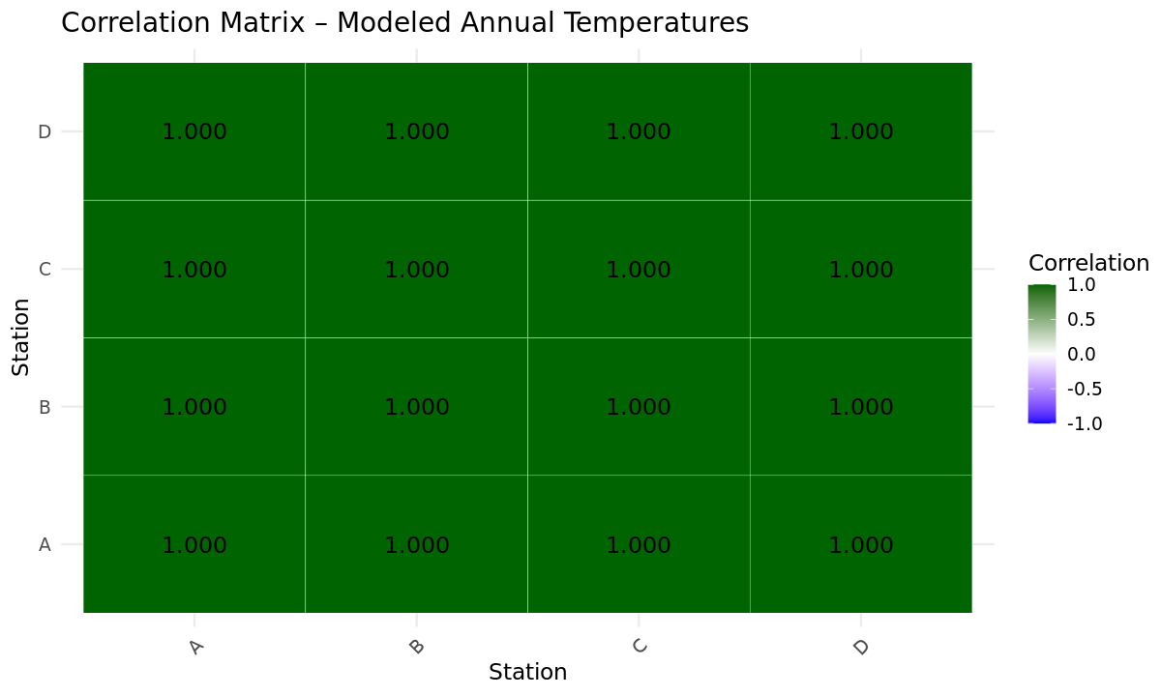
Part 1: Correlation between stations

Slide 14
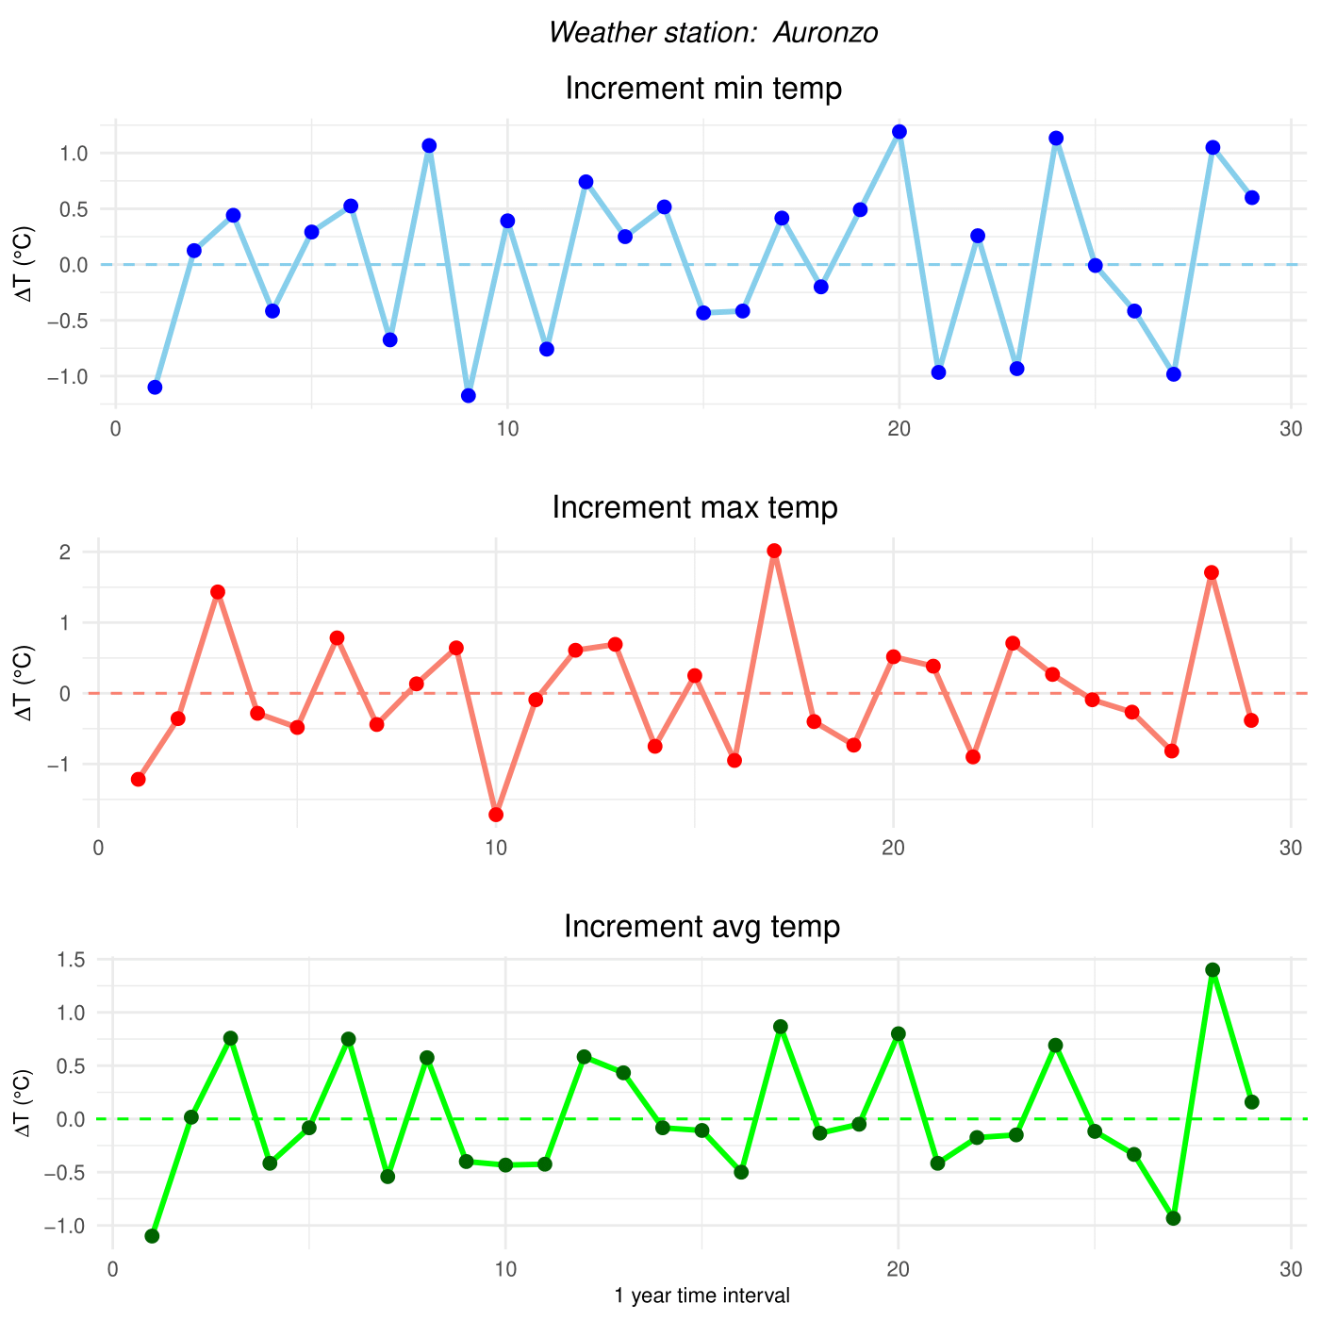
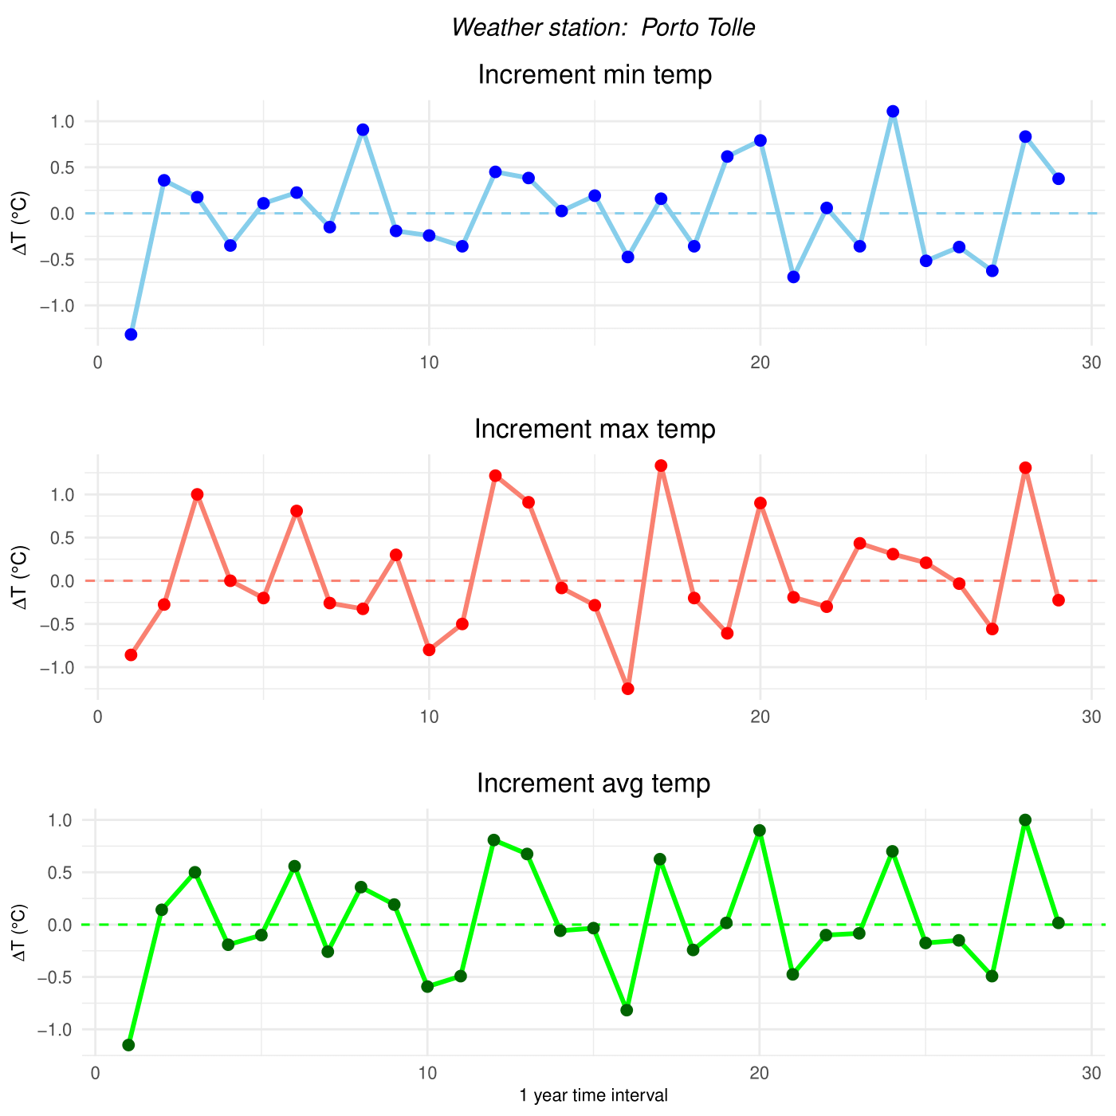
Part 2: Annual temperature changes
To further investigate the increasing trend in temperatures and compare it with official data, we define:
$$ΔT_{j}=T_{j+1}−T_{j}$$
where $T_{j}$ is one of the (mean) temperatures evaluated at year $j$

Slide 15
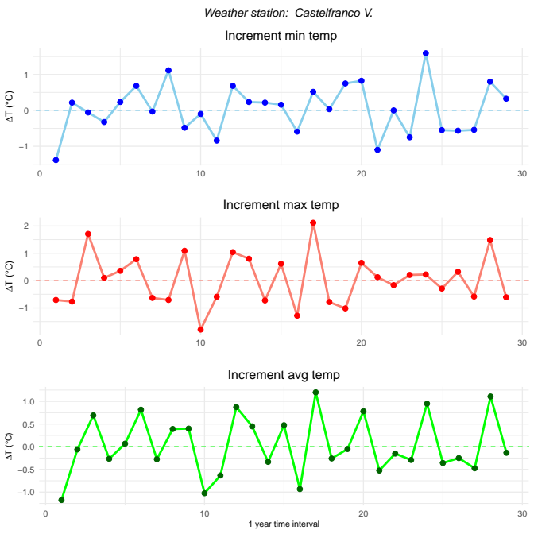
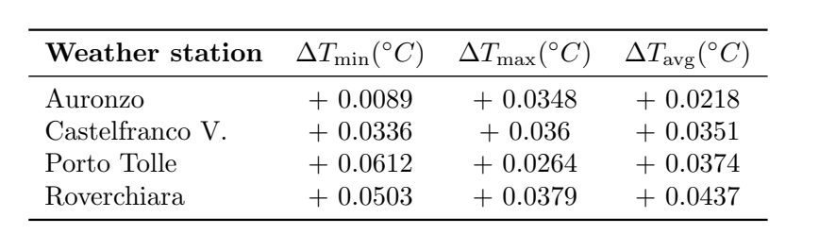

Part 2: Annual temperature changes
Let’s compute the average $ΔT$for all stations to get an initial sense of the overall temperature changes
The average of ΔT is positive for all temperatures types and stations.
This is still a very basic and descriptive insight, not an evidence, just motivating further analysis.

Slide 16
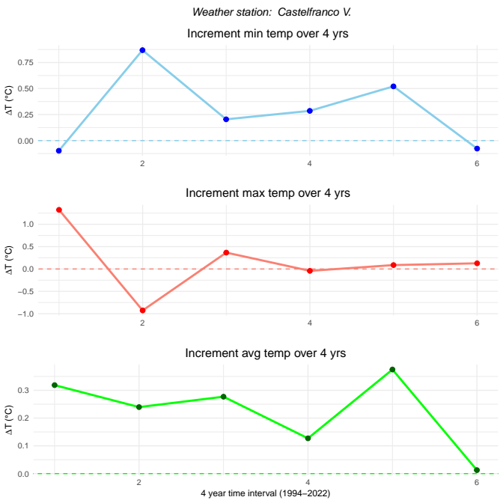
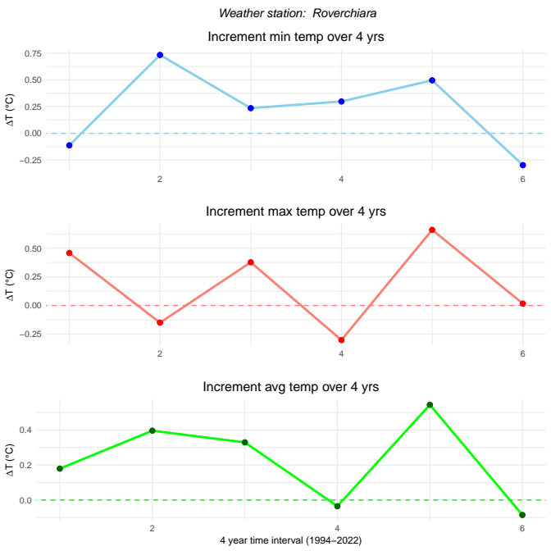
Part 2: 4 Year time interval
To reduce yearly noise and smooth out the signal, we’ll group the time series into 4-year intervals (from 1994 to 2022)
Now the positive trend is a bit more evident, especially when it comes to the daily average temperature

Slide 17
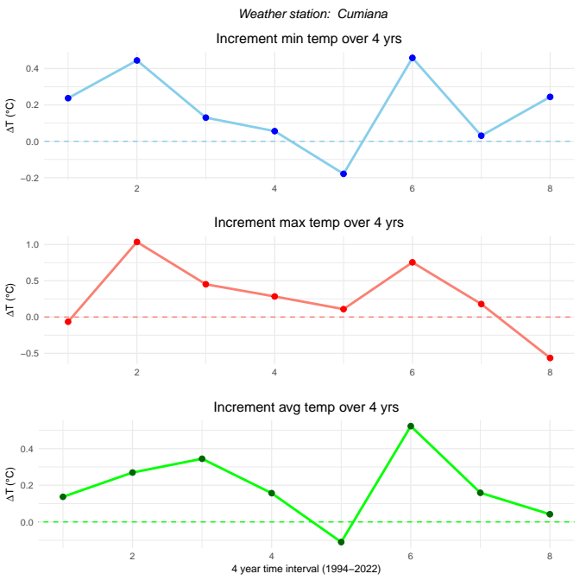

Part 2: More data
ARPA Veneto provides climate data covering only the period from 1994 to the present. Since this results in only 6 points when grouped in 4-year intervals, we searched for older climatic data
Fortunately, ARPA Piemonte offers a bit more coverage (starting from 1987), so we performed our statistical analysis of 4 Piemontese stations too:
- CUMIANA (TO) – 327 m a.s.l.
- ACQUI TERME (AL) – 217 m a.s.l..
- COLLE BARANT (TO) – 2294 m a.s.l.
- GARESSIO (CN) – 980 m a.s.l.
This additional data will come in handy later, when we will compare regional trends to nation-wide predictions made by SNPA
ARPA Piemonte Open data

Slide 18
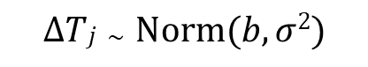
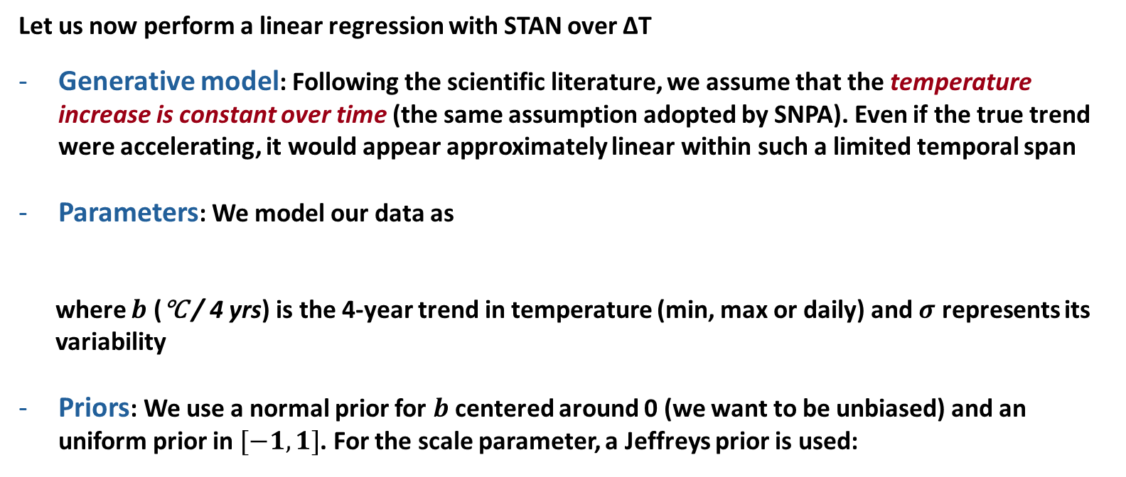
Part 2: Bayesian framework and MCMC analysis
Let us now perform a linear regression with STAN over ΔT
Generative model: Following the scientific literature, we assume that the temperature increase is constant over time (the same assumption adopted by SNPA). Even if the true trend were accelerating, it would appear approximately linear within such a limited temporal span
Parameters: We model our data as
where $b$ (℃ / 4 yrs) is the 4-year trend in temperature (min, max or daily) and $σ$ represents its
variability
Priors: We use a normal prior for $b$ centered around 0 (we want to be unbiased) and an uniform prior in $[−1,1]$. For the scale parameter, a Jeffreys prior is used:
$$ΔTj \sim Norm(b, σ2)$$
Gaussian inference with unknown variance
$$P\left(b\right)\sim Norm\left(0,1\right), Unif\left(−1,1\right), P\left(σ\right)\sim \frac{1}{σ}$$

Slide 19
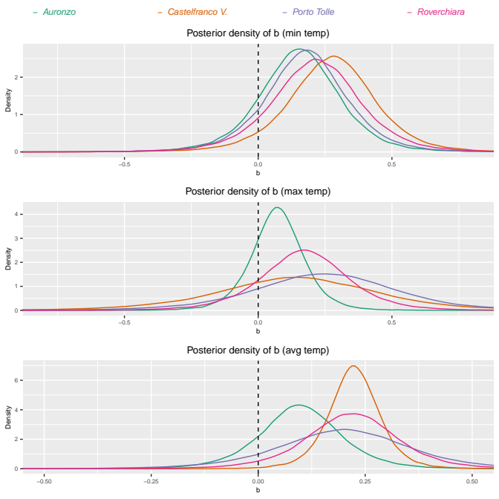
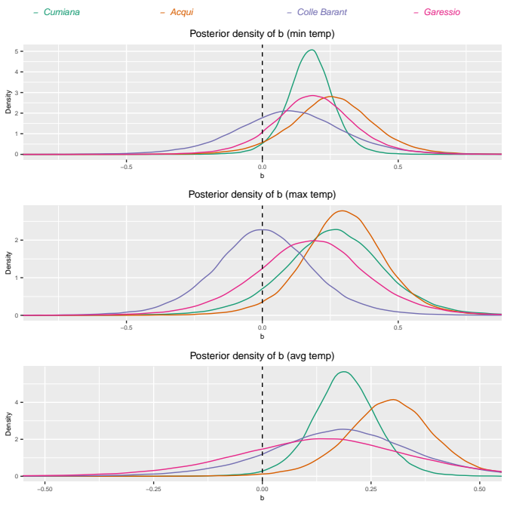

Part 2: Posterior on $b$

Slide 20
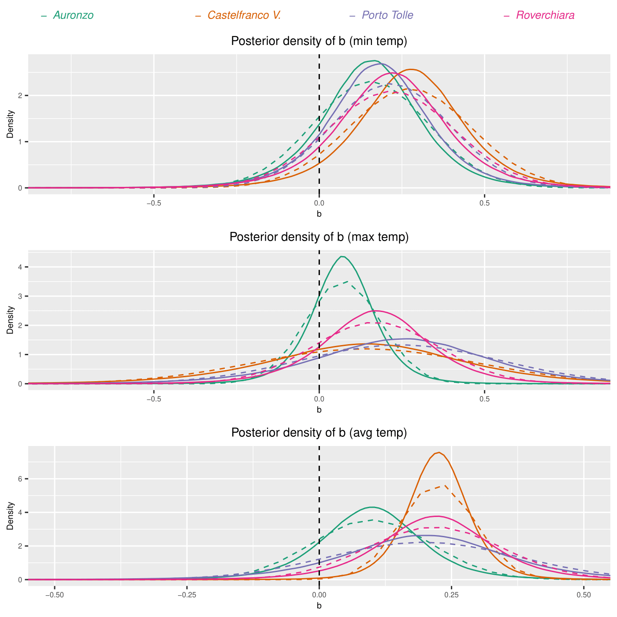
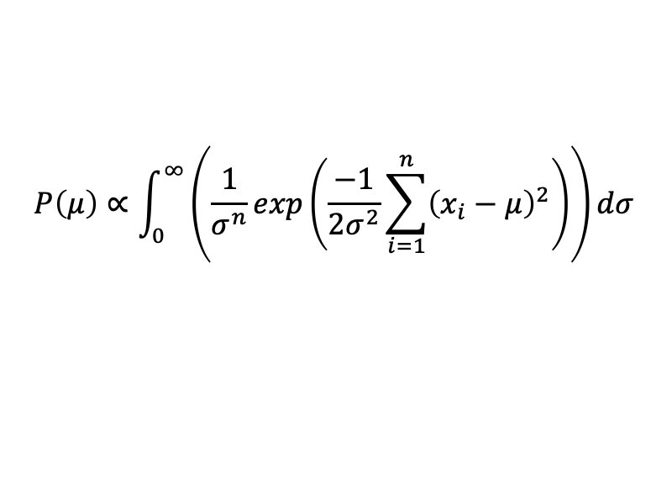
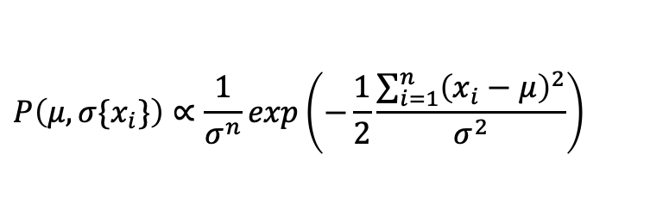
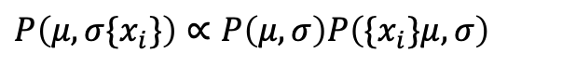
Part 2: Posterior on $b$ – normal or not normal?
A gaussian inference problem with unknown variance doesn’t produce normal posteriors, especially when the samples are few.
Instead, a t-student-like distribution comes up (although not precisely a t-student…)
$$P\left(μ,σ\{x_{i}\}\right)∝P\left(μ,σ\right)P\left(\{x_{i}\}μ,σ\right)$$
$$P\left(μ,σ\{x_{i}\}\right)∝\frac{1}{σ^{n}}exp\left(−\frac{1}{2}\frac{\sum_{i=1}^{n}{{\left(x_{i}−μ\right)}^{2}}}{σ^{2}}\right)$$
$$P\left(μ\right)∝\int_{0}^{∞}{\left(\frac{1}{σ^{n}}exp\left(\frac{−1}{2σ^{2}}\sum_{i=1}^{n}{{\left(x_{i}−μ\right)}^{2}}\right)\right)}dσ$$

Slide 21
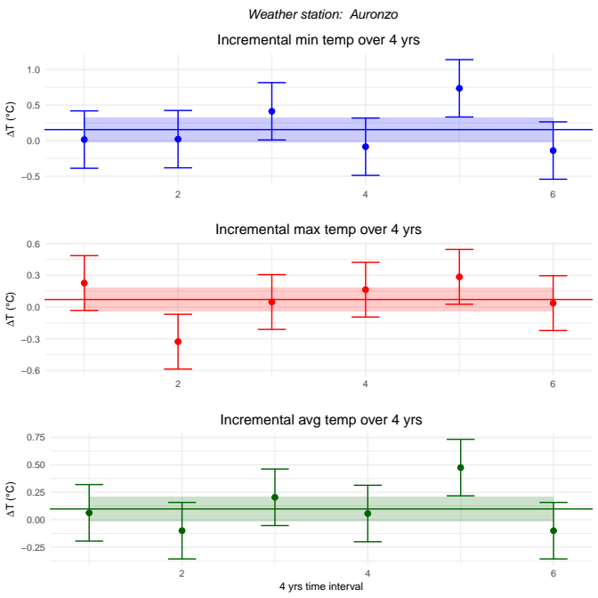
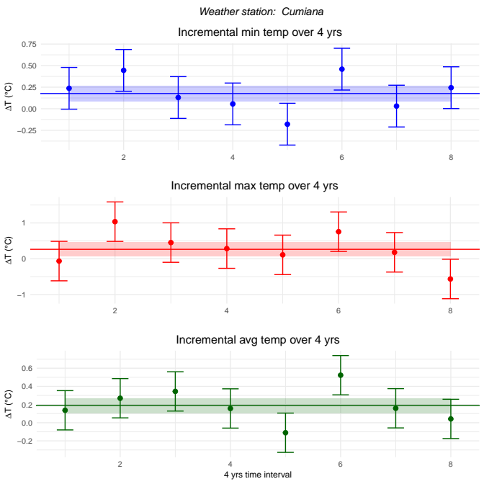
Part 2: Fitted time series
The continuous colored line represents the posterior mean of b, while the surrounding shaded area indicates its posterior standard deviation. The error bars are evaluated as posterior averages over the parameter σ

Slide 22
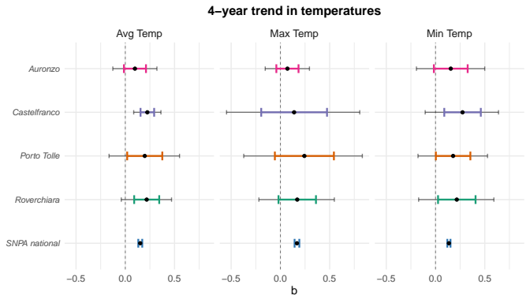

Part 2: Comparing trends with SNPA
SNPA periodically publishes reports in coordination with regional ARPA agencies.
In our analysis, we refer specifically to the 2021 report*. According to this report:
“La stima del rateo di variazione della temperatura media dal 1981 al 2019 è di +0,38 ± 0,05°C/10 anni; il rateo di variazione della temperatura massima (+0,42 ±0,06°C/10 anni) è maggiore di quello della temperatura minima (+0,34 ± 0,04°C/10 anni)”
(*) https://www.snpambiente.it/wp-content/uploads/2021/06/Rapporto-SNPA-21_2021.pdf

Slide 23
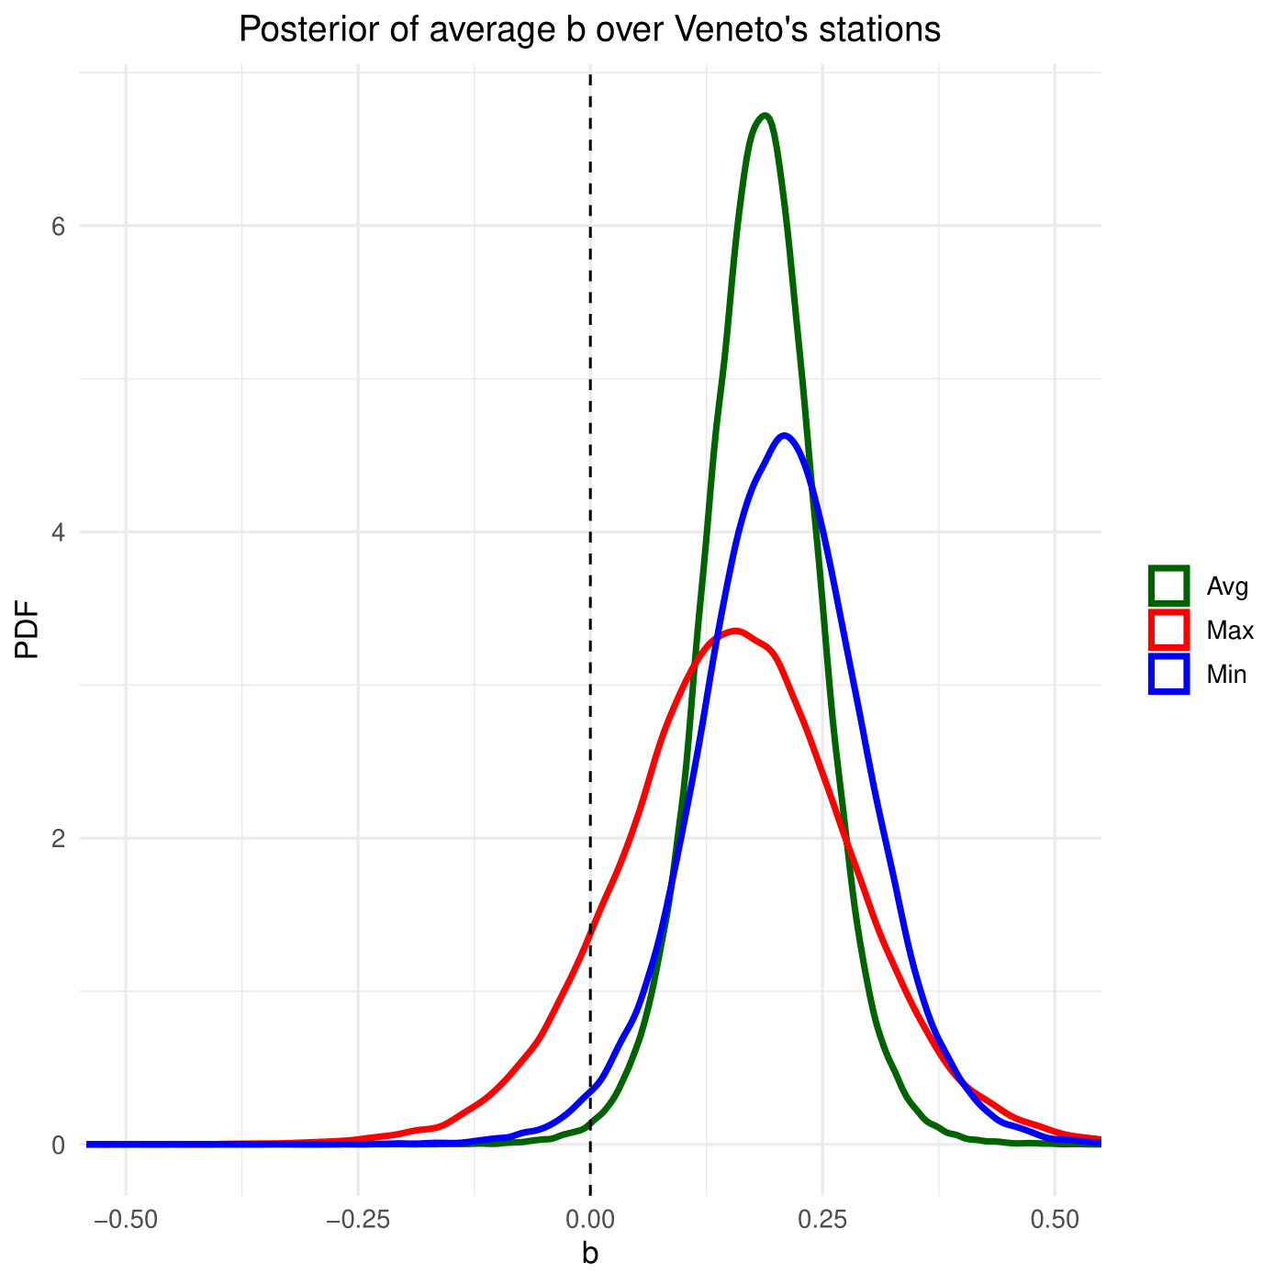
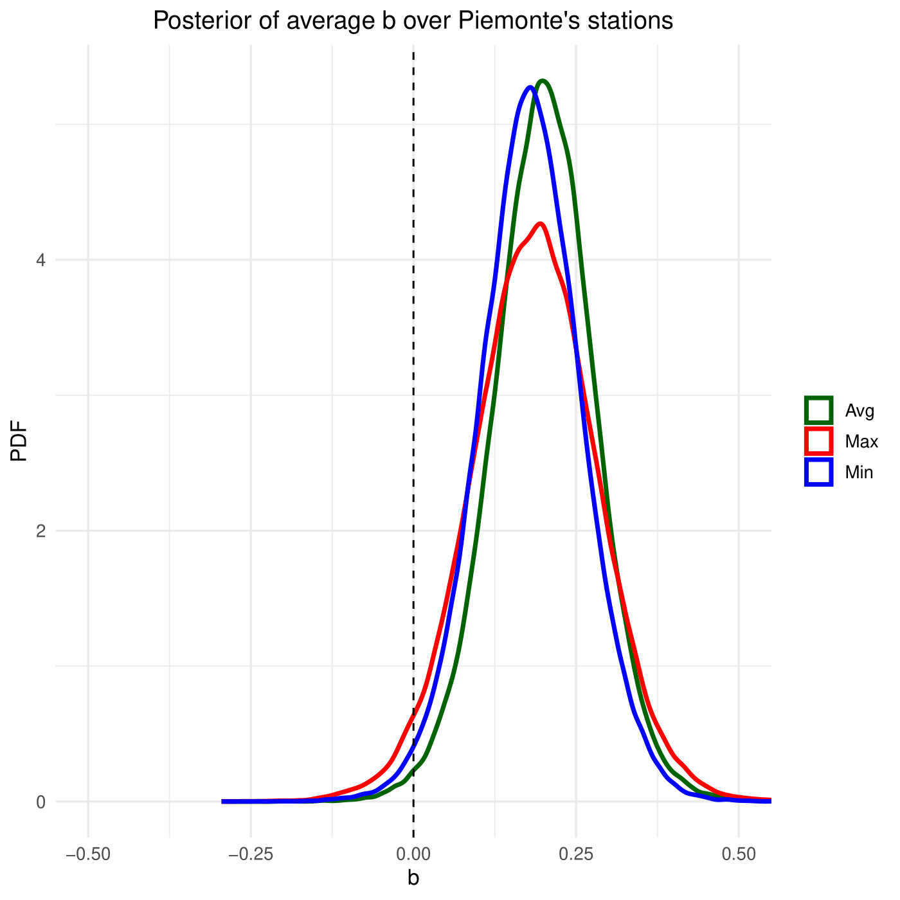

Part 2: Averaging over stations
We’d like to extract a single value for each region by averaging over all stations, i.e. get the regional trend:
$$b_{reg}=\frac{1}{4}\left(b_{1}+b_{2}+b_{3}+b_{4}\right)$$
Unfortunately$, b_{i}$ is not normally distributed and the above average can’t be computed in a close form except for its expected value and variance. Still, we can estimate it numerically with MCMC

Slide 24



Part 2: Final results
Comparing everything with the national-scale SNPA data …
At a 5% level of significance, at least for the min and daily avg temp, we can reject the null hypothesis $H_{0}: b_{reg} = 0$
The results are quite satisfying and appear to be consistent across regions. However, one should test this hypothesis
Results from SNPA always lie in the 95% C.I., so we can’t reject the null hypothesis: $H_{0}:b_{reg}=b_{SNPA}$

Slide 25


Part 2: Comparisons between regions
We have samples coming from the posterior distribution of $b_{p}, b_{v}$ (MCMC w/ STAN). It’s thus easy to build the posterior distribution of the random variable $b_{p}−b_{v}$ and test whether 0 lies in the acceptation region with a significance level of 5%
As a result, we can’t reject the null hypothesis $H_{0}:b_{p}−b_{v}=0$ and we don’t have evidence that support differences in the two regions

Slide 26








Part 3: Temperature forecasting
$$ARIMA(p,d,q)$$
Way to describe non-stationary stochastic proceses $X_{t}$
AutoRegressive Integrated Moving Average
$AR(p)$ Autoregressive: the next value of $X$ at time $t$ is given by a linear combination of previous $p$ variables
$I(d)$ Integrated: differentiation order $d$ in order to make the time series trend stationary
$MA(q)$ Moving average: the next error term is given by a linear combination of the previus $q$ white noises
For time series with a strong seasonal component SARIMA (seasonal ARIMA) is used
$$SARIMA\left(p,d,q\right){\left(P,D,Q\right)}_{m}$$
$AR(P), MA(Q)$ are the same as ARIMA but specified at seasonal lag. $I(D)$ accounts for the number of differentiation to remove the seasonality. $m$ is the number of observations per year
$$MA(q)$$
$$X_{t}=ε_{t}+\sum_{i=1}^{p}{φ_{i}X_{t−i }}+\sum_{i=1}^{q}{θ_{i}ε_{t−i}}$$
$$AR(p)$$
Hyndman, R.J., & Athanasopoulos, G. (2018) Forecasting: principles and practice, 2nd edition, OTexts: Melbourne, Australia.

Slide 27






Part 3: Differentiation order $d$ and $D$
Non-seasonal first-order differentiation
$$X_{t}^{′}=X_{t}−X_{t−1}$$
diff(x, lag = 1, differences = d)
Seasonal first-order differentiation
$$X_{t}^{′}=X_{t}−X_{t−m}$$
diff(x, lag = m, differences = D)
We can determine the number of non-seasonal $d$ and seasonal $D$ differences required for time series to became stationary: KPSS (Kwiatkowski–Phillips–Schmidt–Shin) tests:
$H_{0}:$ the time series is stationary around a deterministic trend
$H_{1}$: the time series has a unit root (not stationary)
d <- ndiffs(x, alpha = 0.05)
D <- nsdiffs(x, alpha = 0.05)
Differentiation order d = 0
Seasonal differentiation order D = 1
This analysis suggests an $ARIMA\left(p,0,q\right){\left(P,1,Q\right)}_{12}$ model
Auronzo di Cadore 1994-2022 average temperatures data

Slide 28






Part 3: AR and MA parameters
The autocorrelation function (ACF) shows the relationship between $X_{t}$ and $X_{t−k}$ for different lags $k$. The partial autocorrelation function (PACF) measure the relationship between $X_{t}$ and $X_{t−k}$ after removing the effects of lags $1,…,k−1$
ACF and PACF can provide qualitative information about the $AR$ and $MA$ orders
$AR(p)$: if the ACF is exponentially decaying and there is a significant spike at lag $p$ in the PACF but none beyond lag $p$
$MA(q)$: if the PACF is exponentially decaying and there is a significant spike at lag $q$ in the ACF but none beyond lag $q$
Seasonality complicates distinguishing between $AR$ and $MA$ components, though their values should be small given the fast decay of both ACF and PACF.
The right figure shows prominent spikes at a one-year lag, suggesting non-zero values for seasonal orders $P$ and/or $Q$

Slide 29





Part 3: AR and MA parameters
We perform an $ARIMA\left(p,1,q\right){\left(P,1,Q\right)}_{12}$ test, evaluating various parameter combinations for $\left(p,q,P,Q\right)∈\{0,1,2\}$ and recording the best results
order.val <- c(p, 0, q)
seasonal.val <- list(order = c(P, 0, Q), period = 12)
fit <- Arima(ts, order.val, seasonal.val)
aic <- AIC(fit)
We use the Akaike Information Criterion (AIC) to evaluate model fit. AIC balances model likelihood $ℒ$ with the number of estimated parameters $N$, penalizing complexity:
Series: ts ARIMA(1,0,1)(0,1,1)[12] Coefficients:
ar1 ma1 sma1
0.5882 -0.4103 -0.9453
s.e. 0.1646 0.1821 0.0473
sigma^2 = 1.732: log likelihood = -580.78
AIC=1169.57 AICc=1169.69 BIC=1184.84
$$AIC=2N−2\ln{ℒ}$$
While the forecast package in R offers auto.arima , it has limitations: it doesn't allow applying the estimated model to new data and can sometimes yield suboptimal results. For instance, auto.arima suggests $ARIMA\left(0,0,3\right){\left(2,1,0\right)}_{12}$ model, but its AIC of $1232.97$ is higher than our best-performing model
This analysis suggests an $ARIMA\left(1,0,1\right){\left(0,1,1\right)}_{12}$ model with AIC of $1169.568$

Slide 30

Part 3: AR and MA parameters
As a sanity check, we confirmed that the residuals behave as Gaussian white noise. The Ljung-Box test quantitatively verifies this by checking if residual autocorrelations are zero.
Ljung-Box test
data: Residuals from ARIMA(1,0,1)(0,1,1)[12]
Q* = 19.825, df = 21, p-value = 0.5323
We fail to reject the null hypothesis. This indicates that the ARIMA model has adequately captured the autocorrelations in the data

Slide 31


Part 3: Forecasting
ARIMA model effectively forecasts 2023 temperatures, with actuals data within the 95% confidence interval
The Root Mean Squared Error is 1.38°C.
The t-test on the forecast residuals (p=0.027) indicates a possible bias. Specifically, our forecast under-estimates the temperature by an average of -0.85°C
Auronzo di Cadore 2023 average temperatures data

Slide 32








Part 3: Forecasting
AURONZO DI CADORE
$$ARIMA\left(2,0,0\right){\left(0,1,1\right)}_{12}$$
AIC: $1247.97$
RMSE: $1.48 °C$
$$ARIMA\left(1,0,1\right){\left(1,1,1\right)}_{12}$$
AIC: $1333.73$
RMSE: $1.49 °C$
$$ARIMA\left(1,0,1\right){\left(1,1,1\right)}_{12}$$
AIC: $1169.57$
RMSE: $1.38 °C$
ROVERCHIARA
$$ARIMA\left(2,0,1\right){\left(2,1,1\right)}_{12}$$
AIC: $1270.70$
RMSE: $1.28 °C$
$$ARIMA\left(2,0,2\right){\left(1,1,1\right)}_{12}$$
AIC: $1313.01$
RMSE: $1.64$°𝑪
$$ARIMA\left(2,0,2\right){\left(2,1,1\right)}_{12}$$
AIC: $1208.64$
RMSE: $1.25 °C$
CASTELFRANCO VENETO
$$ARIMA\left(2,0,1\right){\left(1,1,1\right)}_{12}$$
AIC: $1271.02$
RMSE: $1.31 °C$
$$ARIMA\left(1,0,1\right){\left(0,1,1\right)}_{12}$$
AIC: $1331.08$
RMSE: 𝟏.𝟒0 °𝑪
$$ARIMA\left(2,0,1\right){\left(2,1,1\right)}_{12}$$
AIC: $1222.68$
RMSE: $1.28 °C$
PORTO TOLLE
$$ARIMA\left(1,0,0\right){\left(0,1,1\right)}_{12}$$
AIC: $1184.56$
RMSE: $1.44 °C$
$$ARIMA\left(2,0,1\right){\left(1,1,1\right)}_{12}$$
AIC: $1237.38$
RMSE: $1.41$°𝑪
$$ARIMA\left(1,0,0\right){\left(0,1,1\right)}_{12}$$
AIC: $1151.41$
RMSE: $1.38 °C$

Slide 33



Backup 2: Posterior on $a$
What if we had assumed, for example$:$
$$∆T_{j} \sim Norm\left(aj+b,σ^{2}\right)$$
Always compatible with 0

Slide 34

Backup 2: Compatibility between regions
The regional trends $b_{p}$ and $b_{v}$both have a posterior which is not strictly speaking a gaussian distribution. To test whether the two results are compatible, one should use the t-student distribution.
Using independent flat priors, we estimate the variance as:
${\hat{σ}}^{2}=\frac{{\sum_{i}^{4}{\left(b_{v,i}−{\overline{b}}_{v}\right)}}^{2}+\sum_{i}^{4}{(b_{p,i}−{\overline{b}}_{p})^2}}{n_{1}+n_{2}−2}$
And the (1-$α)$x100% credible interval for $b_{p}$ - $b_{v}$ becomes:
$${\overline{b}}_{p}−{\overline{b}}_{v}±t_{α 2}\hat{σ}\sqrt{1/n_1 +1/n_{2}}$$
Making the computations, one finds that 0 is well inside this interval, so compatibility is statistically claimed with a level of significance of 5%

